Slide 1

EMPLOYEE ATTRITION - Analysis
AJAY
DA&DS - MARCH

Slide 2

Introduction
Employee attrition is a critical issue that affects productivity,
morale, and business performance. This project analyzes
employee data to uncover the key reasons why employees
leave the organization.
Using tools like Power BI, Excel, and DAX, the analysis focuses on
identifying patterns in demographics, job roles, income, and work-life
balance to better understand and reduce attrition.

Slide 3
PROJECT OVERVIEW
Dataset Selection
Data Cleaning & Transformation
DAX Function
DASHBOARD CREATION
Insights & Analysis Report

Slide 4



File: employee_attrition_train.csv:
Records: 1,029 employees
Features: 35 columns
Target: Attrition (Yes/No)
Key Column Types:
Demographics: Age, Gender, Marital Status
Job Info: Department, Job Role, Years At Company
Compensation: Monthly Income, Daily Rate
Behavioral: Over Time, Work Life Balance, Job Satisfaction
⚠️ Missing Data:
Age, Daily Rate, Distance From Home, Business Travel, Marital Status
DATASET
OVER VIEW

Slide 5
Data Cleaning Process :
Handled missing values and replaced .
Encoding categorical data.
Normalization & transformations data .
Removed duplicates or irrelevant data.

Slide 6
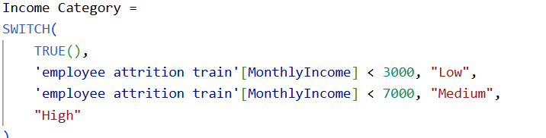
Dax functions:
Snippets of Dax :
Age group
Average income
Average rate per day
Avg total working years
Income category
Total distance
Work experience
Years until retirement
Female employe count
Male employee count

Slide 7
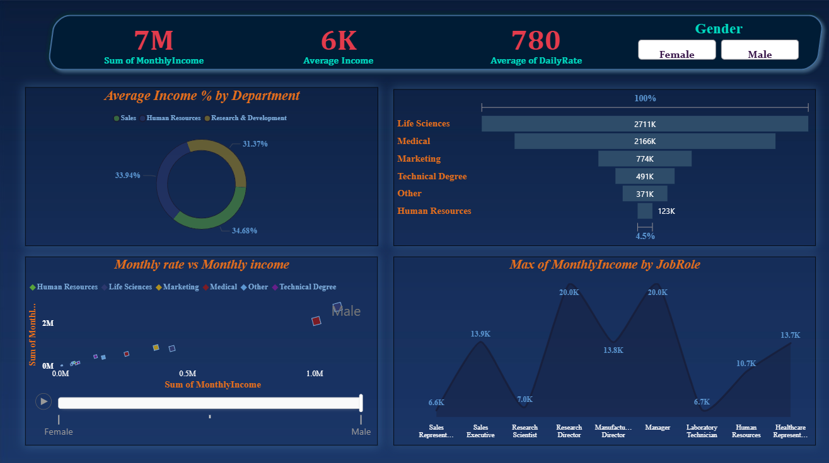
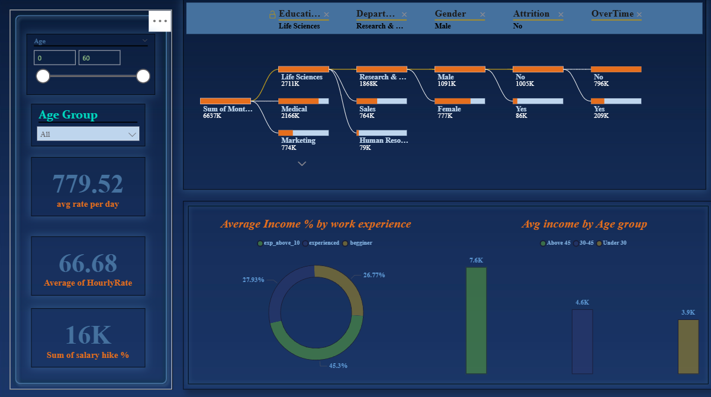
DASHBOARD -1,2

Slide 8
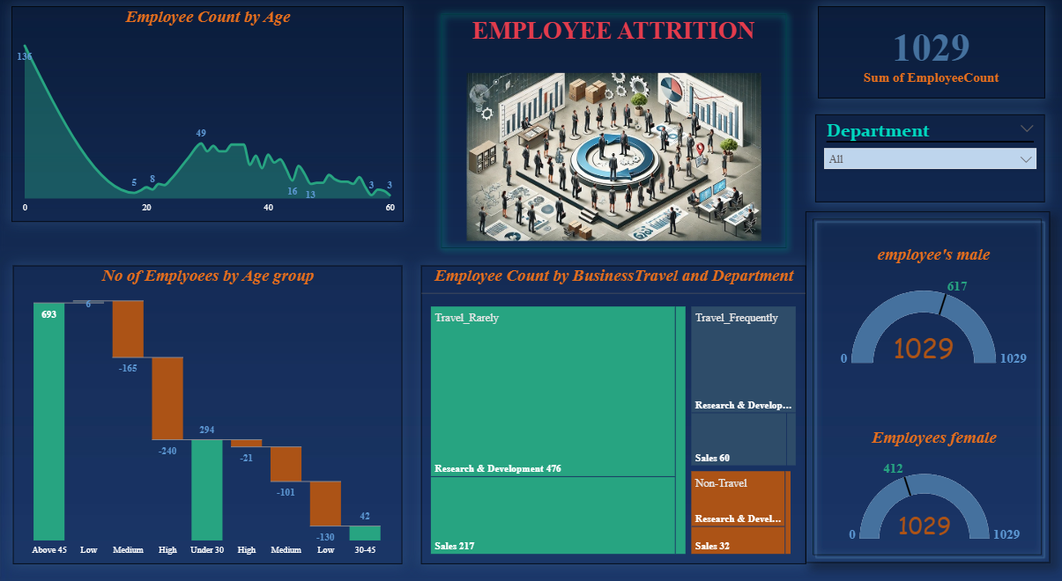
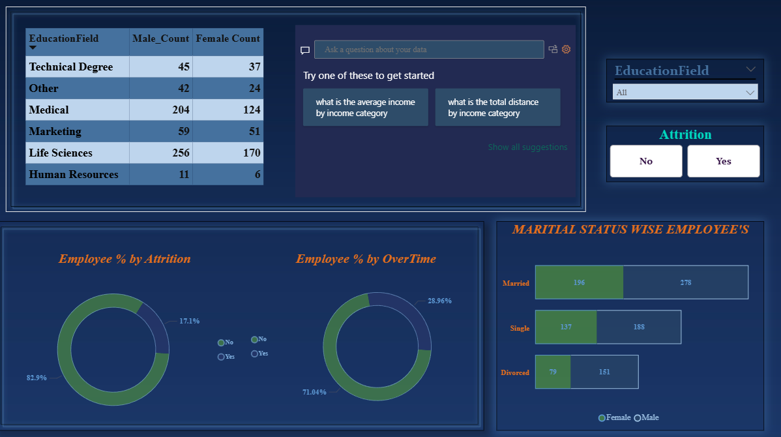
DASHBOARD -3,4

Slide 9


KEY FINDINGS :
Over Time → High Attrition
Low Job Satisfaction → More Attrition
Work-Life Balance & Training Help Retain
Certain Job Roles have higher turnover

Slide 10
CONCLUTION :
Employee attrition is predictable with the right data
Power BI provides actionable, interactive insights
Use insights to reduce turnover & improve retention

Slide 11




Thank you !!
ANY QUERIES

